Slide 1
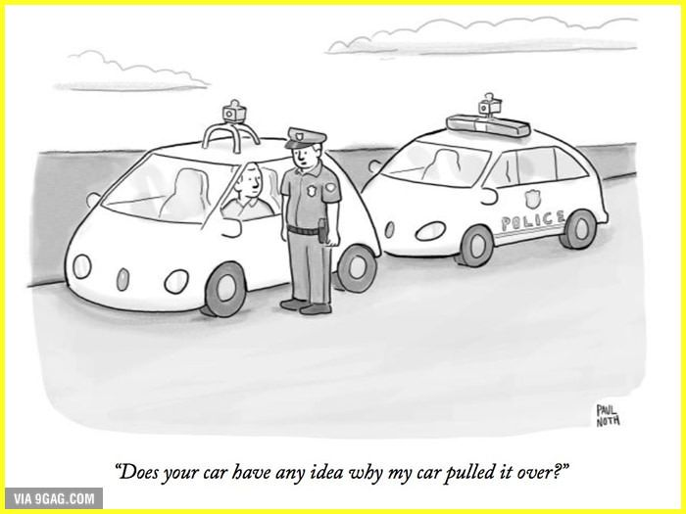

Slide 2
Autonomous cars
Who should be held legally accountable in the event of an accident?

Slide 3
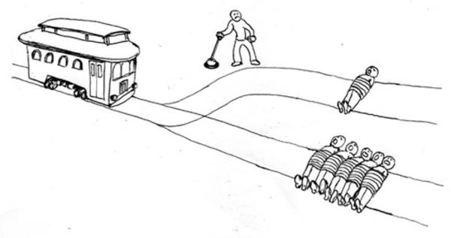

Slide 4
Summary of topics discussed
History of autonomous vehicles
Aims and benefits of driverless cars
Challenges and ambiguities
Potential solutions and approaches

Slide 5
Brief history of autonomous cars
1948 - introduction of cruise control
2009 - Google begins self-driving car project
2013 - Mercedes and Infiniti produce cars with radar sensors and some autonomous driving features
2013 - NHTSA (US traffic safety administration) releases initial policy on autonomous vehicles
2015 - Tesla releases its Auto-Pilot self-driving mode
2016 - Others companies such as GM, Toyota, Uber, Volvo, Ford have their own projects and partnerships
2016 - NHTSA issues guidelines for testing and deployment of autonomous vehicles
2017 - NHTSA issues revised safety guidelines for autonomous vehicles

Slide 6
Aims and benefits of driverless cars
Reduce congestion
Increase in safety
More driver freedom
Quality transport service
Better health
Reduced carbon emissions
New jobs (but also many losses of old jobs)

Slide 7
Challenges and ambiguities

Slide 8
Liability
Who is to blame?
Traditional choices
Owner/driver
Manufacturer
Autonomous choices
Owner/driver/operator
Manufacturer
Company that created the technology

Slide 9
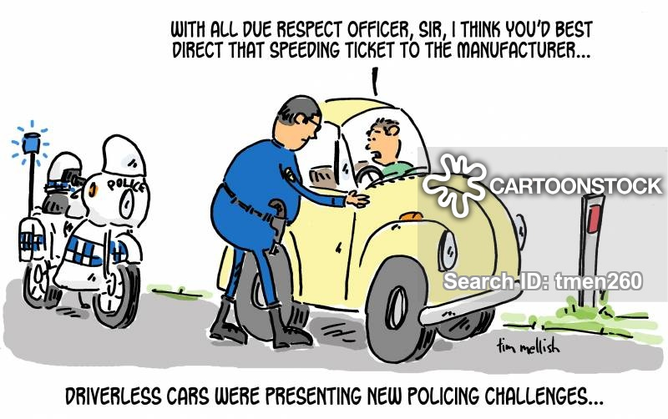

Slide 10
Liability (cont’d)
No legal precedent
Complex issue
Would you rather be hit by a human driver or an AI?
What about cyber liability?

Slide 11
Death algorithms
Algorithms decide
Too many scenarios
Follow the law, crash or finish your journey midway?
‘Why’ is more important than ‘what’
Difficult for humans to justify their own ethics

Slide 12
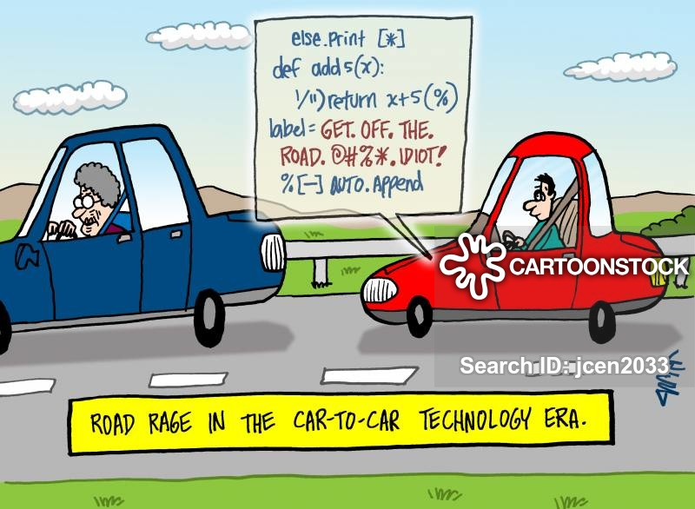

Slide 13
Death algorithms
Algorithms decide
Too many scenarios
Follow the law, crash or finish your journey midway?
‘Why’ is more important than ‘what’
Difficult for humans to justify their own ethics

Slide 14
Reaction vs. decision
Humans react, AIs decide.
Cars don’t have ethics. Companies do.
Ethics dilemma

Slide 15
Potential solutions and approaches
Shared responsibility
Specialised insurers
Software defects as manufacturing defects
Blockchain technology
Operational partition
Decision partition
Ethical education and AI
Regulate ‘black box’ technologies

Slide 16
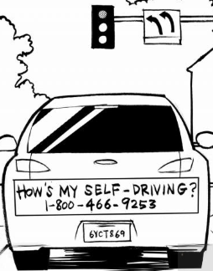

Slide 17
References
http://theconversation.com/whos-to-blame-when-driverless-cars-have-an-accident-93132
https://www.mcca.com/wp-content/uploads/2018/04/Autonomous-Vehicles.pdf
https://futurism.com/images/7-benefits-of-driverless-cars http://theconversation.com/whos-to-blame-when-driverless-cars-have-an-accident-93132
https://pdfs.semanticscholar.org/995c/5c85dc26bd1f2d77e273d58705fc0777ad9c.pdf

